Slide 1


ENTERTAINMENT
X
—Infinite Possibilities
Data Fouced Python (Group 4)
Kehuan Wang | kehuanw@andrew.cmu.edu
Qinyu Zhao | qinyuzha@andrew.cmu.edu
Dan Li | danl2@andrew.cmu.edu
Yile Jiang | yilej@andrew.cmu.edu

Slide 2

AGENDA
Vision
Problem
Solution/Product
Business
Future Inspriation

Slide 3

VISION
Become a widely recognized data service provider for companies by analyzing the commercial value of celebrities.
1

Slide 4





PROBLEM (CUSTOMER PAIN)
Which celebrities I should choose?
Is he really suitable to endorse our products?
idol popularity
“Fake” fans?
The endorsement fees of
artists in different levels vary
greatly.
Some may even up to tens of
millions.
How to measure value?
Cost
The idol popularity is changing fast, and it is difficult for the brand to follow up hotspots and select the most suitable celebrities.
Lack of quantitative methods to measure artist’s commercial value.
Hard to know the number of the artist’s real fans and evaluate the value brought by fan’s active behaviors from social media.
2

Slide 5

Current solution for this pain
Traditional Solution : Experience-based
The traditional method of finding brand celebrities is more subjective. According to its own positioning, the brand analyzes the artists in turn, and makes the decision subjectively based on the comparison of information such as the price/performance ratio, the degree of cooperation of the artists, and the number of fans.
Why is it broken?
The number of celebrities’ fans cannot be directly transformed
into the brand’s consumers.
The data that the brand achieve to analyze the celebrity
image may be false or outdated, so their decisions may
be lagging behind and out of sync with the market.
Our Solution : Data Driven
Using data to give a ranking of celebrities in multiple dimensions, such as public popularity, business value.
3

Slide 6




Why ?
is so difficult to choose the “right” superstar?
Don’t worry!
Entertainment X will help you!
4

Slide 7

Product: Data-driven Celebrity Evaluation System
5

Slide 8
Based on Multidimensional-source data
Social platform: Weibo
Evaluation
System
Video service platform: Bilibili
1. Give a ranking of celebrities in multiple dimensions, such as public popularity, business value.
Online community platform: Douban
2. Provide both general analysis report and customized analysis report.
6

Slide 9

Product: Data-driven Celebrity Evaluation System
Development process
1.Scrape data from internet.
5.Make a evaluation report format
4. Visualize data and build a dashboard
2.Clean data into a well format.
3. Make a evaluation model
Composite index = Public Popularity Index + Social Platform Index + Business value index
7

Slide 10



How to use our product
Give a celebrity name
Optional Functions
Include in database -> give a general ranking Immediately
Not include in database -> scrape related data from website first and then after process data, give a general ranking
Ranking in different dimensions
Data analysis report (eg. fan composition analysis)
8

Slide 11



Evaluation model
Composite index = Public Popularity Index + Social Platform Index + Business value index
We decompose each major index into 3 small indexes,
After analyzing and assigning points to the data of each index, we get the comprehensive index of the celebrity
Business value index
Public Popularity Index
A
c
w1:proportion of repost type(Weibo)
w2:proportion of adverting content(Weibo)
w5:num_forwarding(Weibo)
w4:num_comments(Weibo)
b1:num_views/video(Bilibili)
d1:num_comments/work (Douban)
Social Platform Index
B
w3:num_likes(weibo)
d2:recommendation level(Douban)
d3:num_likes(Douban)
9

Slide 12

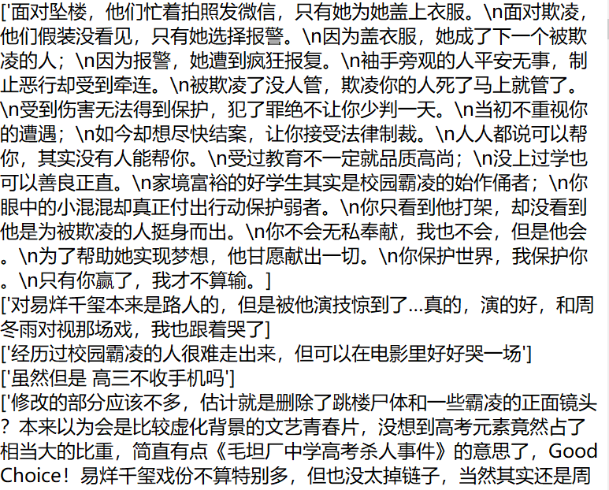

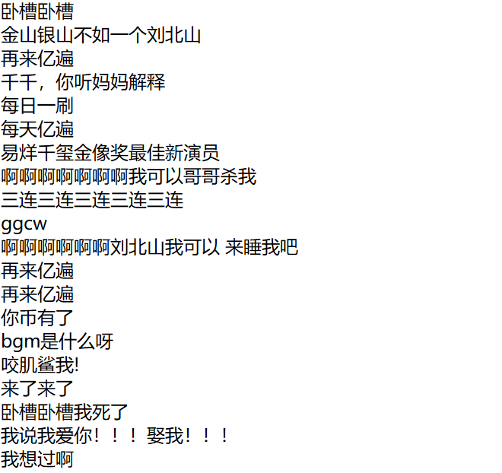

Data Set about Jackson Yi
Data source: Bilibili, Douban and Weibo.
Generated data: 3 raw data worksheets, 3 clean data (extracted from corresponding raw data) worksheets and 2 text files.
Douban Comments
Clean Data from Bilibili
Clean Data from Bouban
Bilbili Barrage
Clean Data from Weibo
10

Slide 13

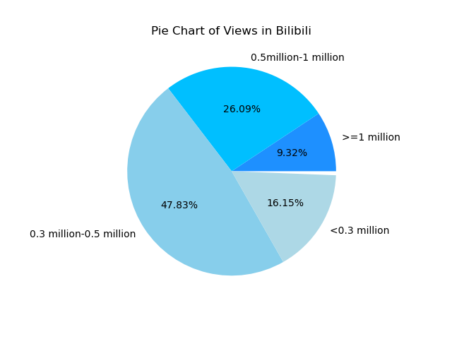
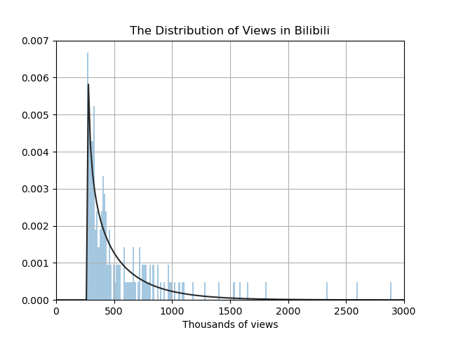

Sample Analysis(b1:num_views/video)
From the distribution chart of playback volume, we observe that most of the playback volume of this part of the video is concentrated in 0.3million-1million, and a small part of the video playback volume is above 10 million.
Through analysis, we score b2, Jackson Yi's b2(num_views) score is 5.44.
Barrage word cloud
11
Figure1 Figure2 Figure3

Slide 14

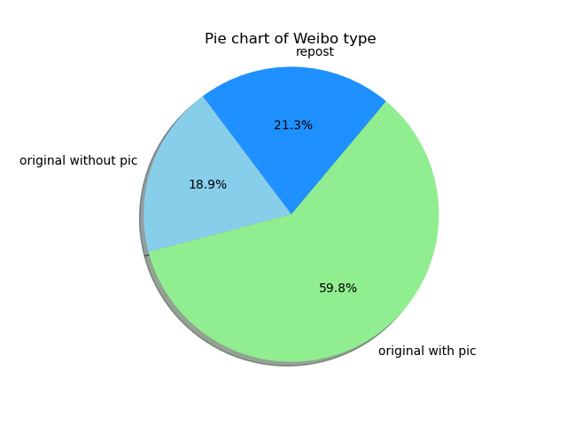
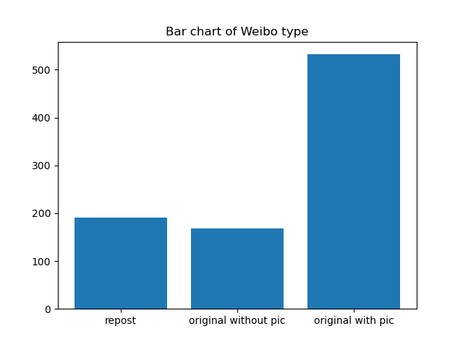
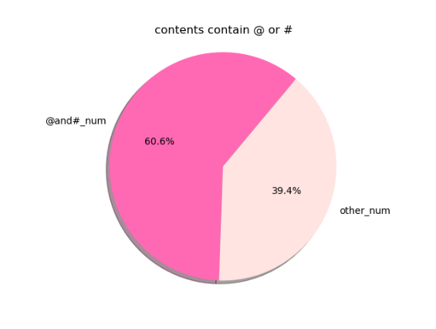
Sample Analysis(w1:weibo_type，w2:weibo_content)
W1 (type type): There are 3 types of weibo: repost/original without pic/original with pic
The repost weibo can be regarded as related to commercial activities.
From the figure1, we can see that the proportion of reposted Weibo accounted for 21.3%.So Yi’s w1 was assigned scores 2.13.
W2(contents): The Weibo of @和# is related to commercial activities.
From the figure3, it can be seen that the proportion of Weibo with @和# accounts for 60.6%.So Yi’s w2 was assigned scores 6.06.
10
12
11
Figure1 Figure2 Figure3

Slide 15

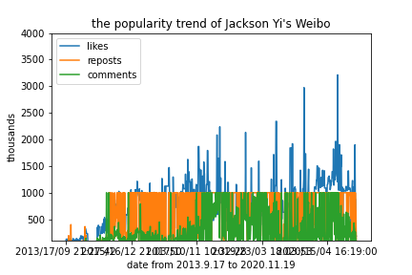
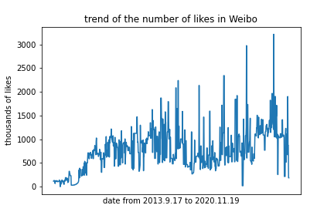
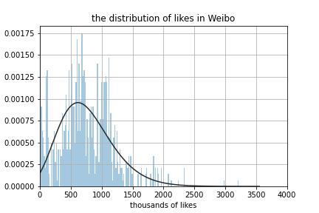
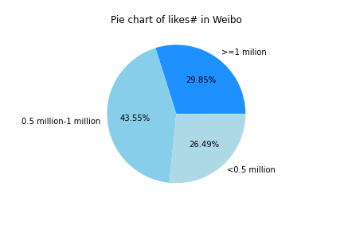
Sample Analysis——w3:num_likes(weibo)
In the figure1, from September 17, 2013 to November 19, 2020, Jackson Yi's Weibo popularity is on the rise, especially in likes.
Figure2 shows us the trend of num_likes of Yi’s Weibo.
From the distribution of likes of figure3, we can see that the number of weibo's likes in each Yi's is mostly between 500,000 and 1 million.
According to the like# pie chart, when like#>1million, score is assigned by 10,
when like# in (0.5million,1millon), score is 5, when like# < 0.5million,score is 2.
Hence, Yi’s w3 score is 5.70.
Figure1 Figure2 Figure3 Figure4
13

Slide 16

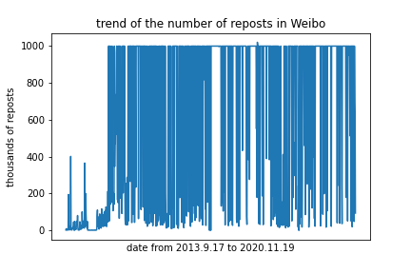
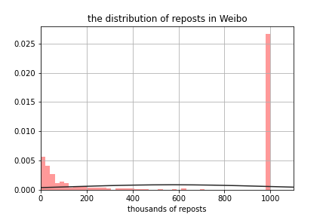
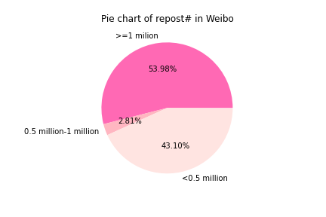
Sample Analysis——w4:num_repost(weibo)
Figure1 shows us the trend of num_reposts of Yi’s Weibo.
Figure2 shows us the distribution of reposts of Yi’s Weibo. We can see, most of Yi’s weibo were be reposted more than 1 million times.
According to the repost# pie chart, when repost# >1million, score is assigned by 10,
when repost# in (0.5million,1millon), score is 5, when repost# < 0.5million,score is 2.
Hence, Yi’s w4 score is 6.40.
Figure1 Figure2 Figure3
14

Slide 17

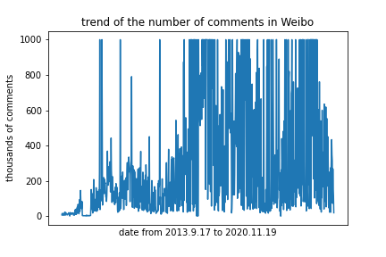
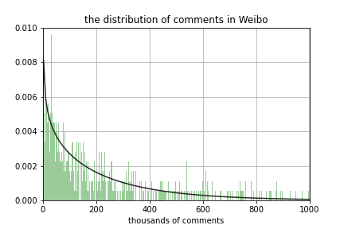
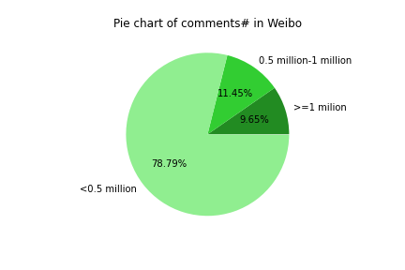
Sample Analysis——w5:num_comment(weibo)
Figure1 shows us the trend of num_ comment of Yi’s Weibo.
Figure2 shows us the distribution of comments of Yi’s Weibo.
According to the comments # pie chart,
when comments # >1million, score is assigned by 10
when comments # in (0.5million,1millon), score is 5
when repost# < 0.5million,score is 2.
Hence, Yi’s w5 score is 3.12.
Figure1 Figure2 Figure3
15

Slide 18

Sample Analysis——d1:comments#/work (Douban)
d2: recommend level(Douban)
Figure1 shows us num_ comments of Works by Yi.
num_comments/work (Douban)
For those work whose num_comments more than 800,000, 10 marks will be given.
For those work whose num_comments between 400,000 and 800,000, 8 marks will be given.
For those work whose num_comments between 100,000 and 400,000, 6 marks will be given.
For those work whose num_comments between 50,000 and 100,000, 4 marks will be given.
For those work whose num_comments below 50,000, 2 marks will be given.
Hence, Yi’s d1 score is 6.00
Figure2 shows us recommendation level of Yi’s masterpiece.
According to the comments # pie chart,
when very satisfied, score is assigned by 10
when recommended, score is 8
when fair< 500,score is 4.
When poor, score is 2.
When very poor, score is 0.
Hence, Yi’s d2 score is 8.60.
Recommendation level
16
Figure1 Figure2

Slide 19

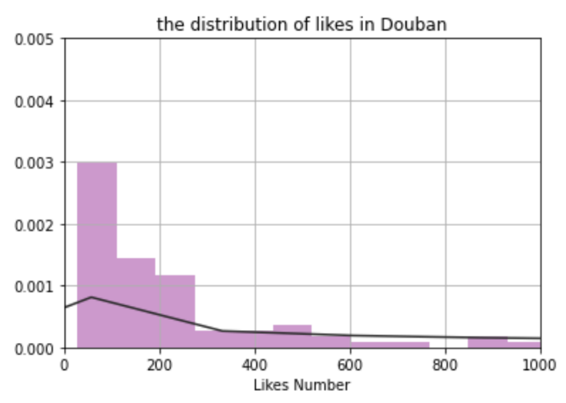
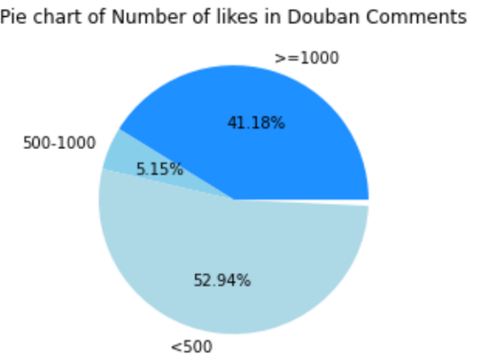

Sample Analysis——d3: num_likes(Douban)
Figure1 shows us the trend of num_ likes in “Young you”——A masterpiece of Yi.
num_comments/work (Douban)
Figure2 shows us likes in comments of “Young you” .
According to the comments # pie chart,
when like#/comments > 1000, score is assigned by 10
when 500 < like#/comments < 1000, score is 5
when like#/comments < 500,score is 2.
Hence, Yi’s d3 score is 5.44.
Barrage word cloud
Figure1 Figure2 Figure3
17

Slide 20

The Composite index =52.66
A
+ B
+ C
Public Popularity Index
Social Platform Index
Business value index*4/3
w4:num_comments(Weibo)= 6.40
b1:num_views/video(Bilibili)= 5.44
d1:num_comments/work (Douban)= 6.00
w3:num_likes(weibo)= 5.70
d2:recommendation level(Douban)= 8.60
d3:num_likes(Douban) = 5.44
w1:proportion of repost type(Weibo)= 2.13
w2:proportion of adverting content(Weibo)= 6.06
w5:num_forwarding(Weibo)= 3.12
18

Slide 21
Pricing details
9.9
15.99
29.99
49.99
79.99
$
$
$
$
$
Only $ 9.9
viewing the score of celebrities evaluation index.
Only $15.99 View a detailed analysis report of a celebrity in the system.
180-day membership
Only $29.99
365-day membership
Only $49.99
720-day membership
Only $79.99
Order now
Order now
Order now
Order now
Order now
Private customized service:
$31.99 for general user to customize a detailed report of a star outside our system
$20.99 for prime membership to customize a detailed report of a star outside our system
19
Notes:
Generally pricing:
$9.9 view scores of each evaluation index
$15.99 View a detailed analysis report of a celebrity in the system
Prime membership:
180-day membership $29.99: Within 180 days, you are able to view scores of each evaluation index of all celebrities in the system for free.
You can select 3 stars in the system and view our analysis reports about them.
365-day membership $49.99: Within 365 days, you are able to view scores of each evaluation index of all celebrities in the system for free.
You can select 3 stars in the system and view our analysis reports about them.
You can also customize an analysis report of a star outside our system.
720-day membership $79.99: Within 365 days, you are able to view scores of each evaluation index of all celebrities in the system for free.
You can select 3 stars in the system and view our analysis reports about them.
You can also customize analysis reports of 3 star outside our system.
Private customized service:
$31.99 for general user to customize a detailed report of a star ouside our system
$20.99 for prime membership to customize a detailed report of a star ouside our system

Slide 22
Average Order Value (AOV)
Orders/Year：
Revenue： more than $ 23794.4 a year
Average order value more than $29.743
800
180-day prime members
Orders to view detailed evaluation indexes：
Orders for viewing star’s reports
230
360-day prime members
170
Orders for customized reports
110
140
720-day prime members
90
60
20

Slide 23
LAUNCH STRATEGY
1. Use social media such as “Weibo”, “Douban”, “Bilibili” to place ads to attract customers.
3. Every customer can get a ranking of celebrities in multiple dimensions, which contains public popularity, business value through a free account.
New
Customers
Customer
Ads
Prime
Members
2. Encourage users to introduce new users to use our products, and give certain member rewards to both sides.
4. Users can get more dimensions of our information consulting services after paying for a prime privilege.
21

Slide 24
Profitability Analysis
Others
We will also display some advertisement for superstars and companies.
And we will provide Star Advisory Service.
Provide services for our Prime Members(Main)
when EntertainmentX(our company) gains enough Prime Members. We will provide them Composite index, Public Popularity Index, Social Platform Index, Business value index for every superstar they like. And provide then the additional analysis report they need.
Celebrity Management System
We will provide our celebrity management system to brokerage companies to help them better manage their artists and develop their commercial value
22

Slide 25
Potential milestones
Firstly
we will build an information database of Chinese super star based on the Social media’s data to provide information support for subsequent analysis reports.
23

Slide 26
Potential milestones
Secondly, we will distinguish Chinese celebrities’ fans in different industries(or cities) to form different analysis reports of stars in each industry(cities).
Harbin
Urumqi
Hohhot
Beijing
Changchun
Shenyang
Xining
Yinchuan
Lanzhou
Nanjing
Lhasa
Chengdu
Chongqing
Suzhou
Guiyang
Changsha
Kunming
Guangzhou
Hangzhou
Shanghai
Kunshan
Taiwan
Hainan
24

Slide 27

Potential milestones
Finally, we will investigate and analyze the unexpected stars in other regions in China, and form a huge celebrity database for users to consult.
West America
Europe
East America
Japan
China
Middle East
Singapore
Australia
25

Slide 28
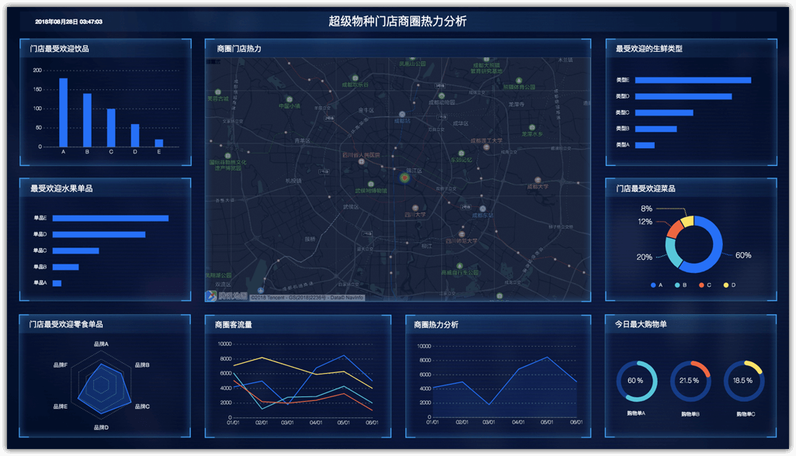
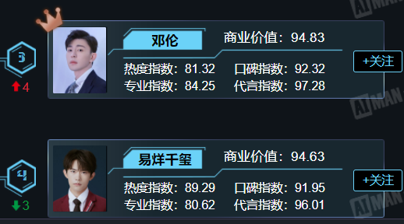
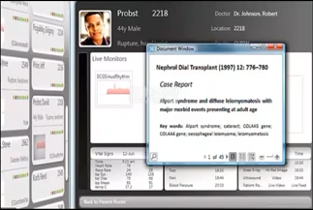
Future Inspiration
Financial Requirement
Raise $0.5 million and sell 49% of the shares
We will finish…
Rich Data Sources
Expand our data from platforms other than Weibo, Station B, and Douban, such as tictoc and Kwai.
Rich List of Analysis Objects
Collecting more data which is about the celebrities and Net popular persons.
Improve User Operation Interface
We will improve our UI interface wo help our customer to use our product easily.
Advertise for EntertainmentX
We will advertise on different platforms to attract customers.
26

Slide 29

Thank you
X
Entertainment Infinite possibilities

